Slide 2
Design and Analysis of Algorithms
Introduction
Unit 1

Slide 3
Time Analysis
Provides upper and lower bounds of running time.
Different types of analysis:
- Worst case
- Best case
- Average case

Slide 4
Worst Case
Provides an upper bound on running time.
An absolute guarantee that the algorithm would not run longer, no matter what the inputs are.

Slide 5
Best Case
Provides a lower bound on running time.
Input is the one for which the algorithm runs the fastest.

Slide 6
Average Case
Provides an estimate of “average” running time.
Assumes that the input is random.
Useful when best/worst cases do not happen very often (i.e., few input cases lead to best/worst cases).

Slide 7
Comparing algorithms
Given two algorithms having running times f(n) and g(n), how do we decide which one is faster?
Compare “rates of growth” of f(n) and g(n)

Slide 8
Asymptotic Analysis
Study of change in performance of the algorithm with the change in the order of the input size is defined as asymptotic analysis.

Slide 9
Asymptotic Notations
Mathematical notations used to describe the running time of an algorithm when the input tends towards a particular value or a limiting value.

Slide 10
Asymptotic Notation
O notation: asymptotic “less than”: Upper Bound f(n)=O(g(n)) implies: f(n) “≤” g(n)
Ω notation: asymptotic “greater than”: Lower Bound
f(n)= Ω (g(n)) implies: f(n) “≥” g(n)
Θ notation: asymptotic “equality”: Average/Tight Bound
f(n)= Θ (g(n)) implies: f(n) “=” g(n)

Slide 11
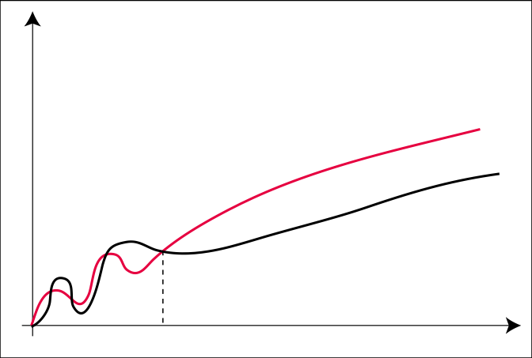
The O-Notation (Upper Bound)
O(g(n)) = { f(n) : ∃c > 0, n₀ > 0 s.t. ∀n ≥ n₀: f(n) ≤ c ⋅ g(n) }
c ⋅ g
f
n₀

Slide 12
Asymptotic O Notation
O notation: asymptotic “less than”:
f(n)=O(g(n)) implies: f(n) “≤” c g(n) in the limit*
c is a constant
(used in worst-case analysis)
*formal definition in CS477/677

Slide 13
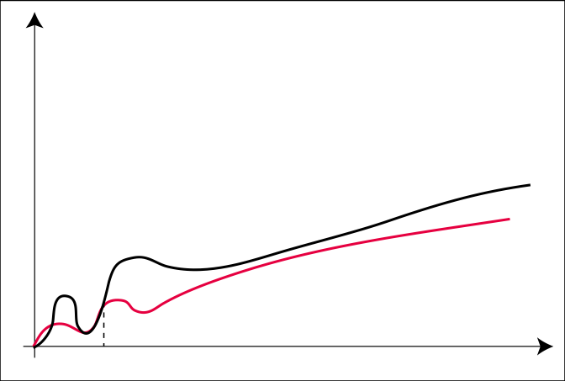
The Ω-Notation (Lower Bound)
Ω(g(n)) = { f(n) : ∃c > 0, n₀ > 0 s.t. ∀n ≥ n₀: f(n) ≥ c ⋅ g(n) }
f
c ⋅ g
n₀

Slide 14
Asymptotic Notation
Ω notation: asymptotic “greater than”:
f(n)= Ω (g(n)) implies: f(n) “≥” c g(n) in the limit*
c is a constant
(used in best-case analysis)
*formal definition in CS477/677

Slide 15
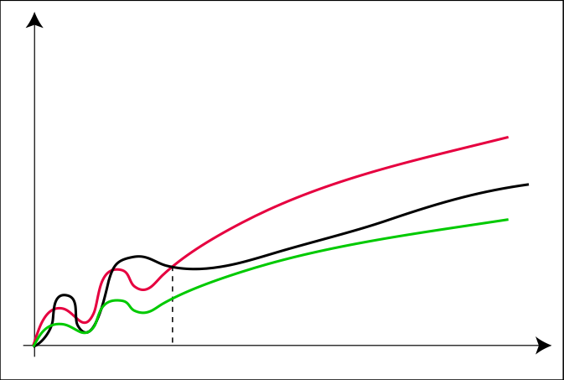
The Θ-Notation (Average Bound)
Θ(g(n)) = { f(n) : ∃c₁, c₂ > 0, n₀ > 0 s.t. ∀n ≥ n₀: c₁ · g(n) ≤ f(n) ≤ c₂ ⋅ g(n) }
c₂ ⋅ g
f
c₁ ⋅ g
n₀

Slide 16
Asymptotic Θ Notation (Average Bound)
Θ notation: asymptotic “equality”:
f(n)= Θ (g(n)) implies: f(n) “=” c g(n) in the limit*
c is a constant
(provides a tight bound of running time)
(best and worst cases are same)
*formal definition in CS477/677

